Slide 1
Energy in space

Slide 2
Dot product

Slide 3
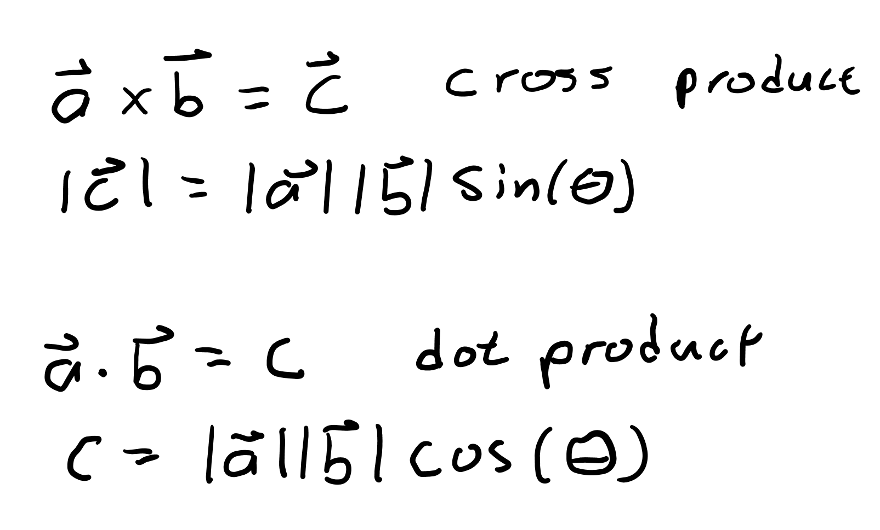
Vector multiplication
A cross product, represented as “x”, multiplies two vectors and gives a new, perpendicular, vector as a result.
A dot product, represented as “*” or “⋅”, multiplies two vectors, but gives a scalar as a result.

Slide 4
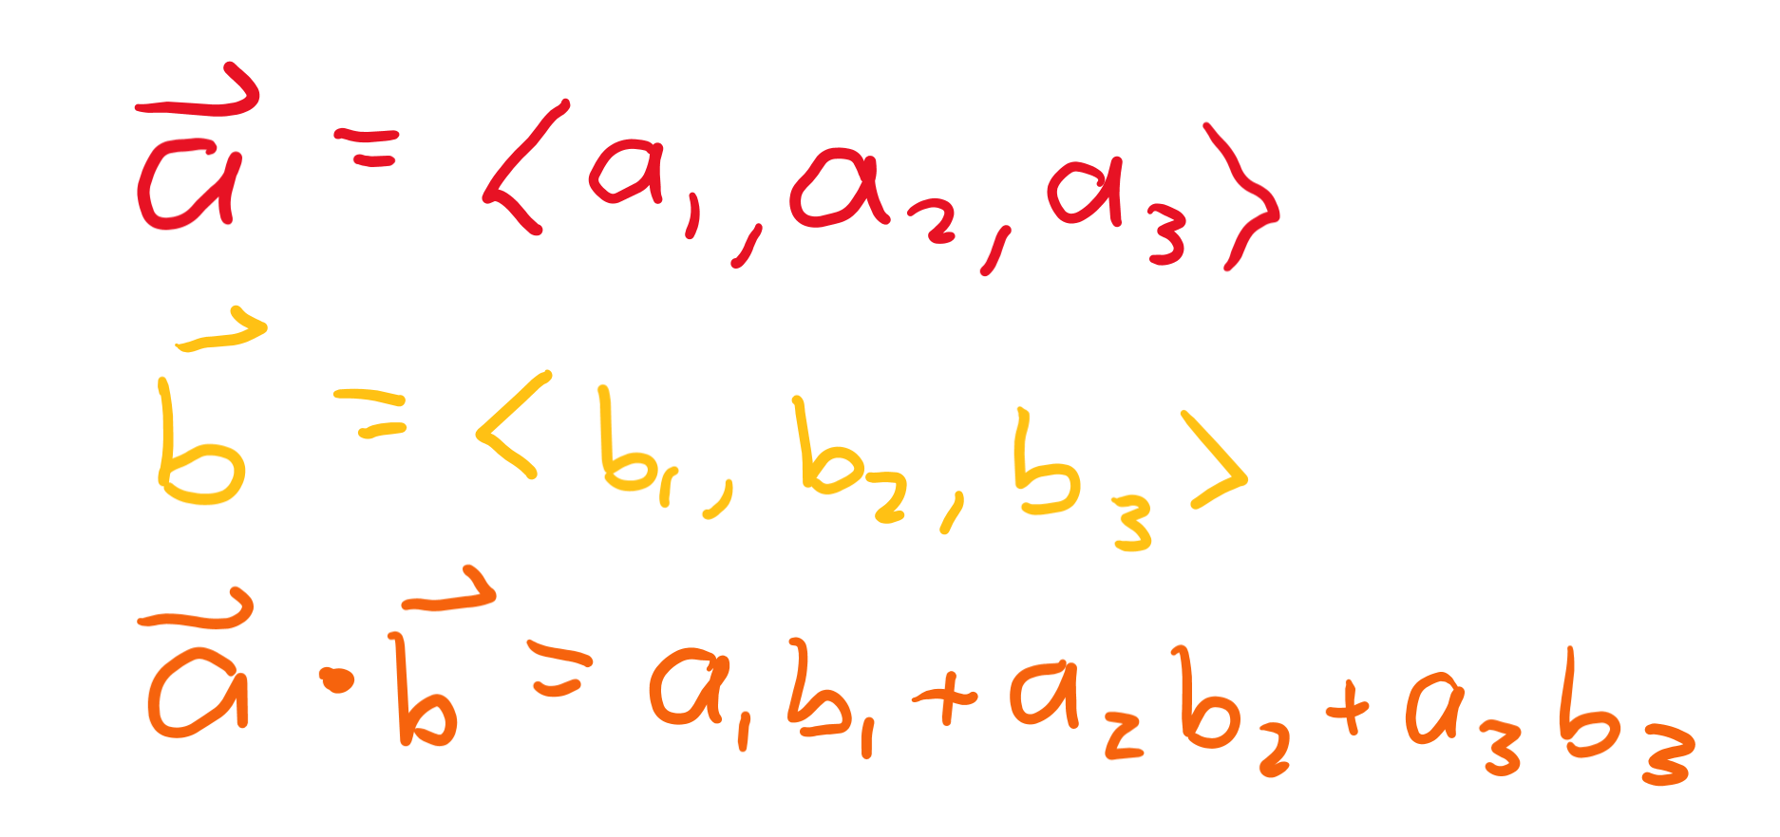
Dot product
Unlike a cross product which only works for 2, 3, 7 dimensions, dot products apply to every dimension.
Vectors <a, b, c> and <x, y, z> have a dot product of ax+by+cz, where you sum the product of each matching term in the vectors.

Slide 5
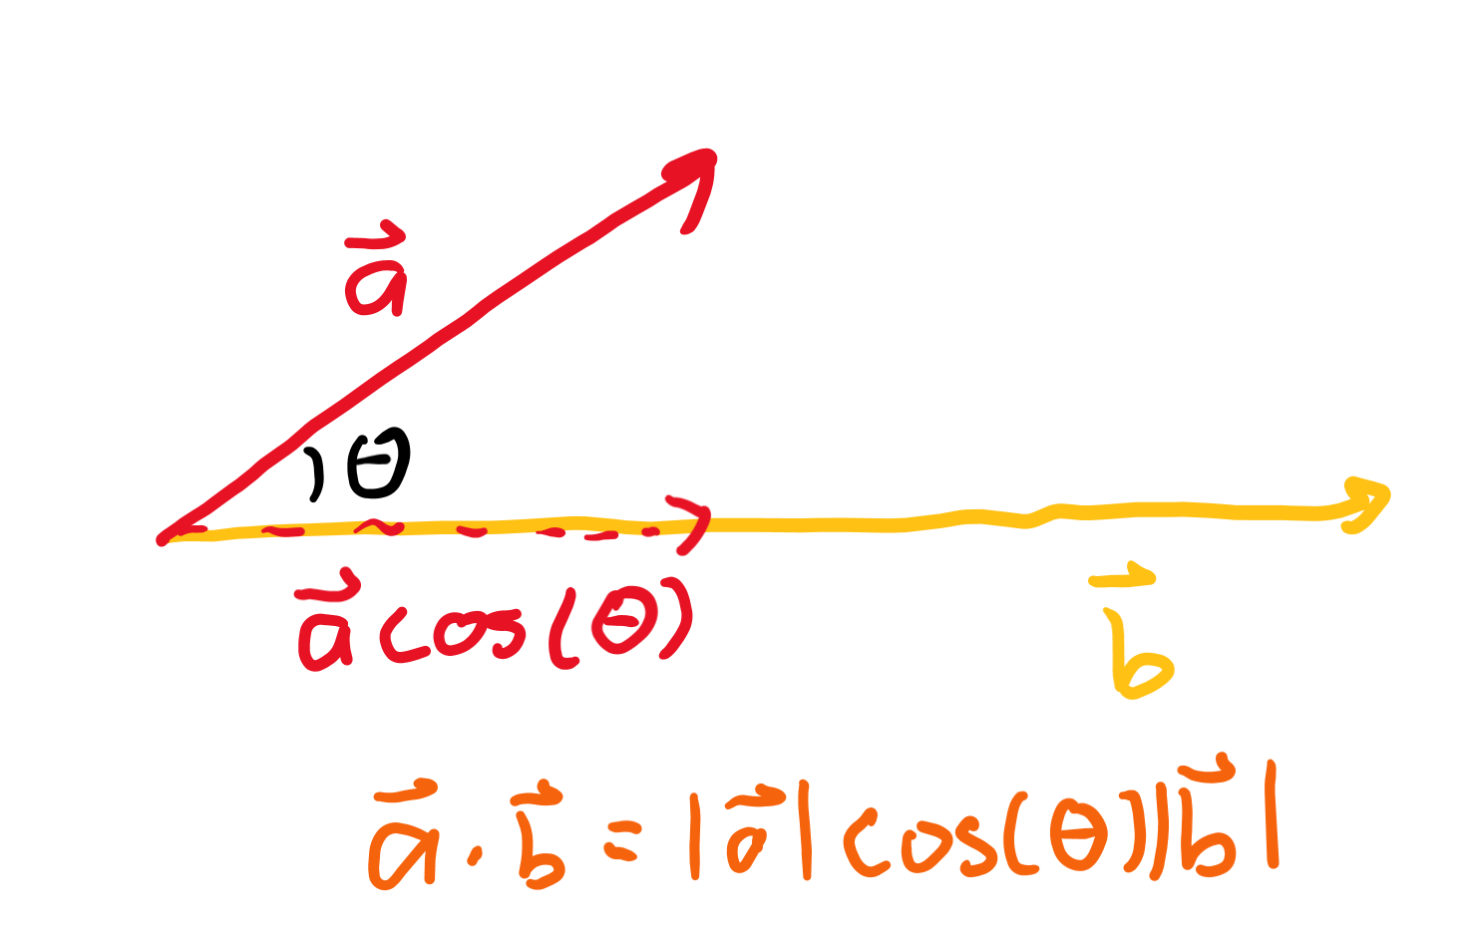
Magnitude approach
Another way to take the dot product of a * b for vectors a, b is to do |a||b|cos(θ).
This is equivalent to multiplying the magnitude of vector components parallel to each other.

Slide 6
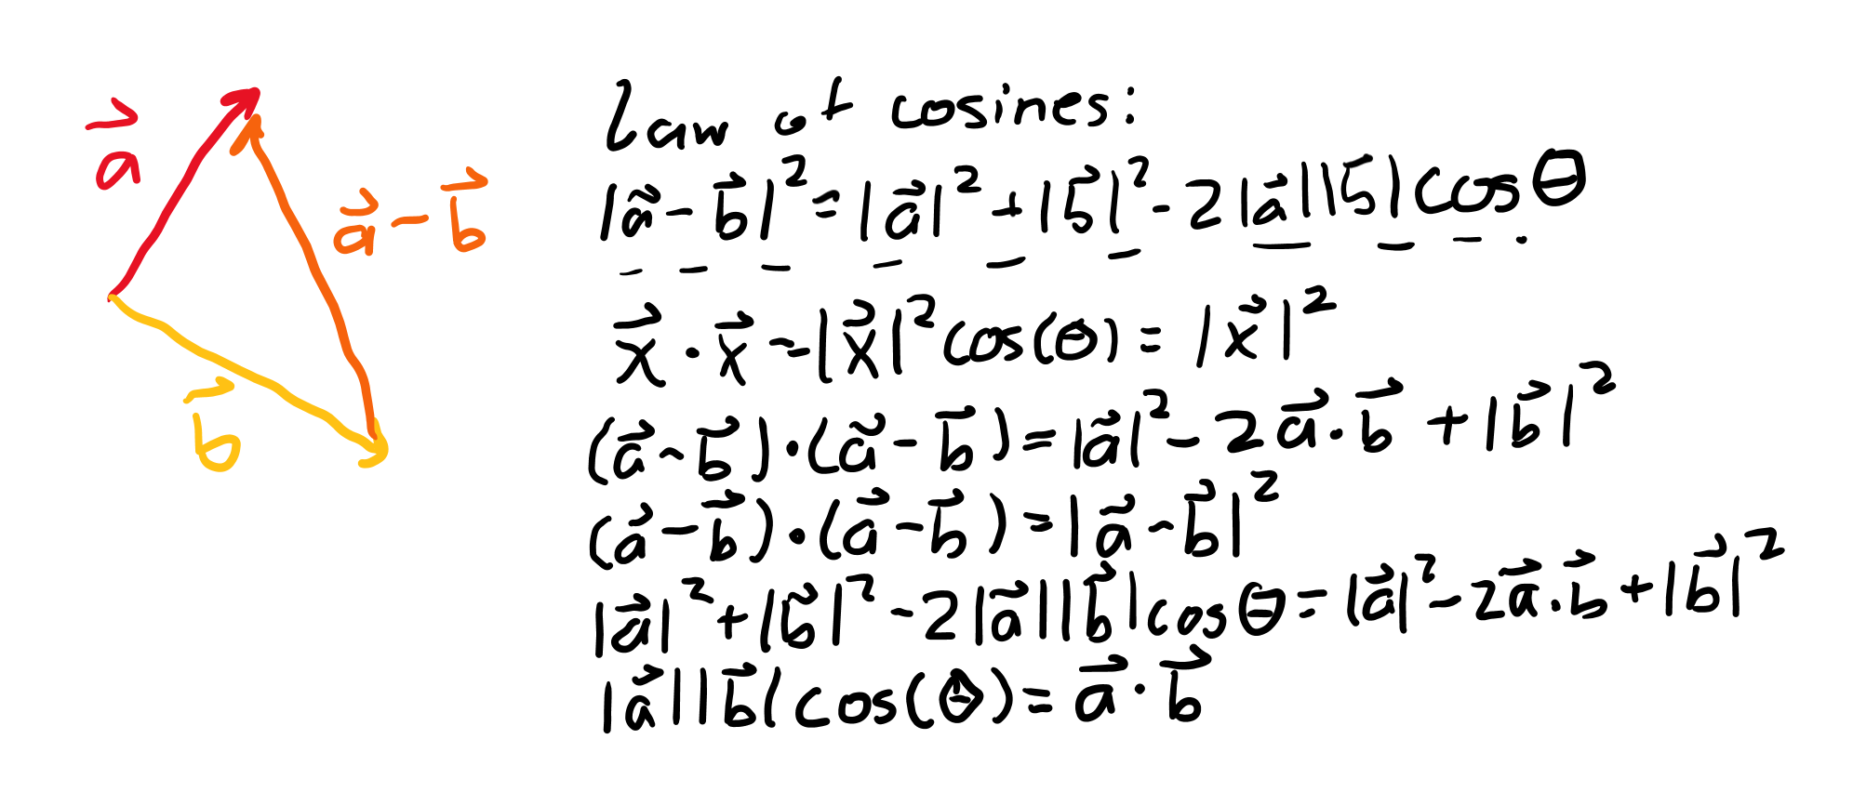
Both approaches give the same thing

Slide 7
Conservative forces

Slide 8
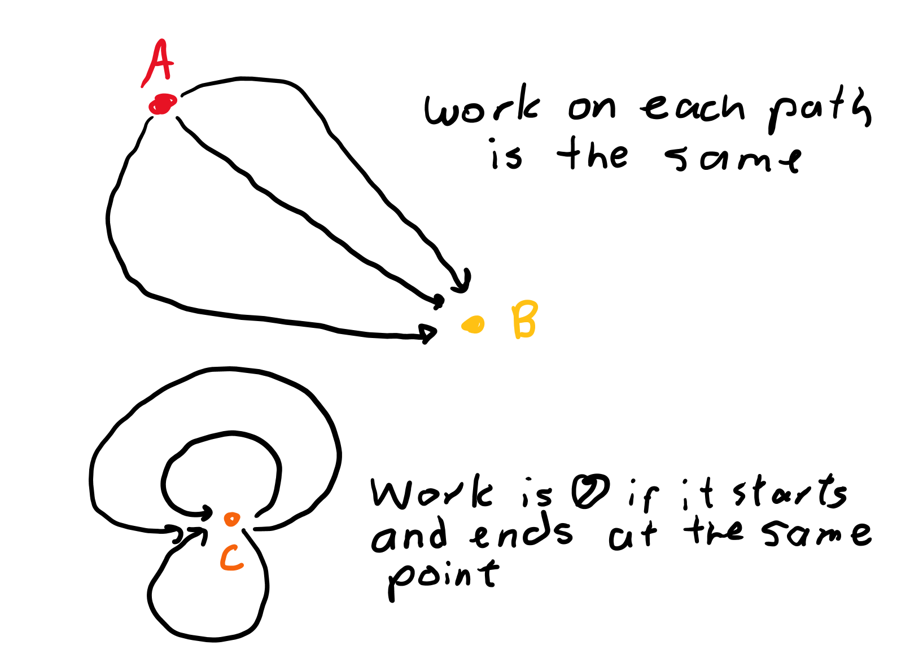
What are they
These are forces that decrease potential energy of a system.
Since potential energy is about the position and structure of a system, the work done by a conservative force from point a to point b is the same no matter what path is taken.

Slide 9
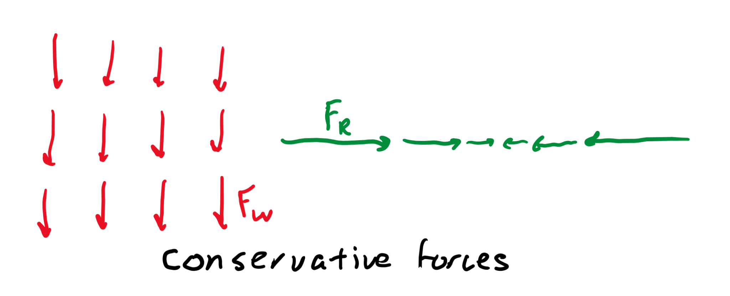
Examples
The restoring force of a spring reduces the spring potential energy and depends only on how far you stretch it out.
Gravitational force reduces gravitational potential energy and depends on how far you are from a mass.

Slide 10
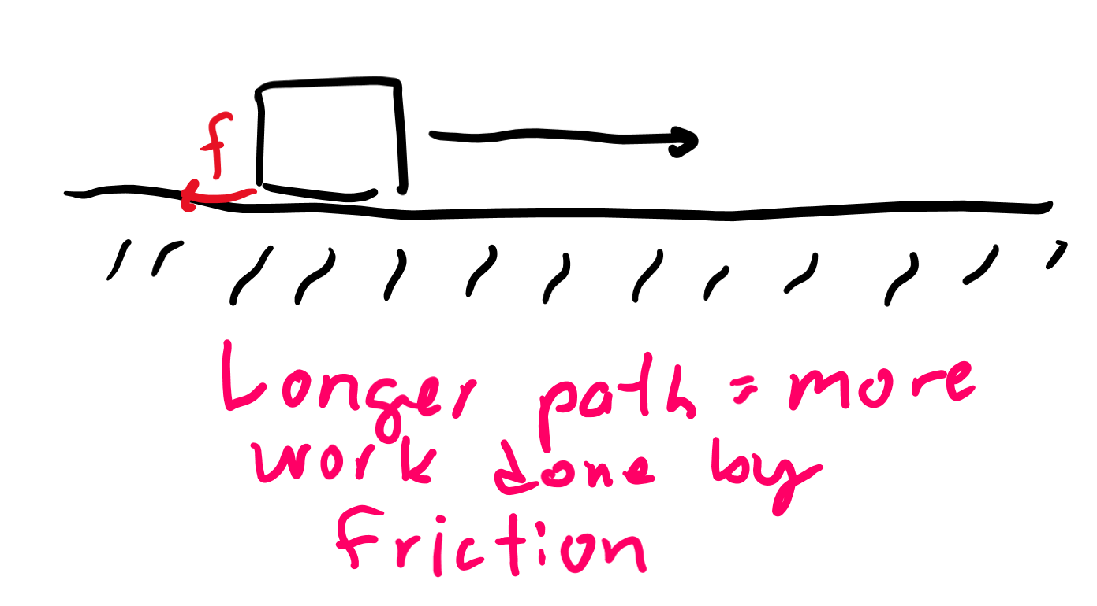
Non-examples
Friction does more work the more you travel: if you travel from a to b to a to b, the work done is different than just going from a to b despite the overall change being from point a to point b for both.
Non-conservative forces like friction generally increase the internal energy of a system (produce heat).

Slide 11
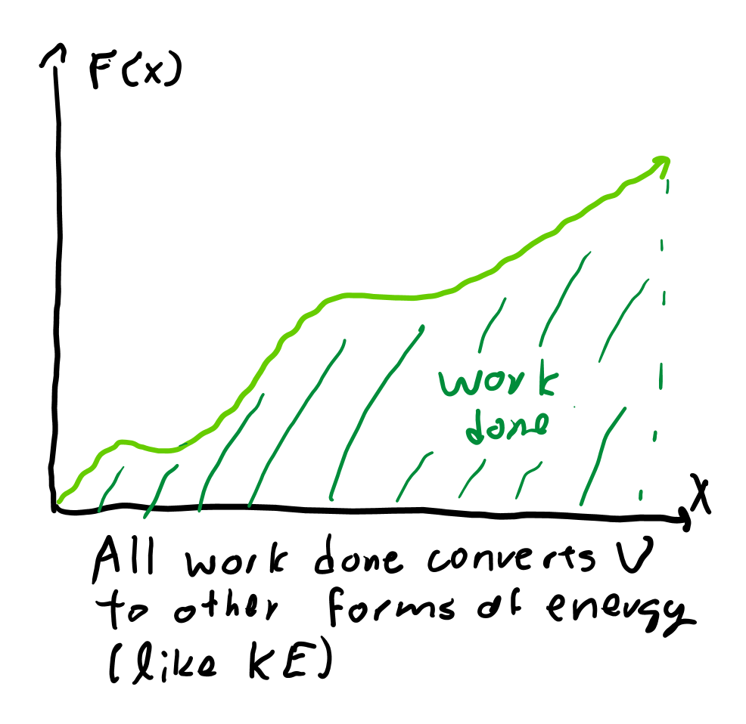
Energy relationship
As conservative forces decrease the potential energy of a system, ∫F(x)dx = -U(x) for some conservative force F(x) and some potential energy U(x).

Slide 12
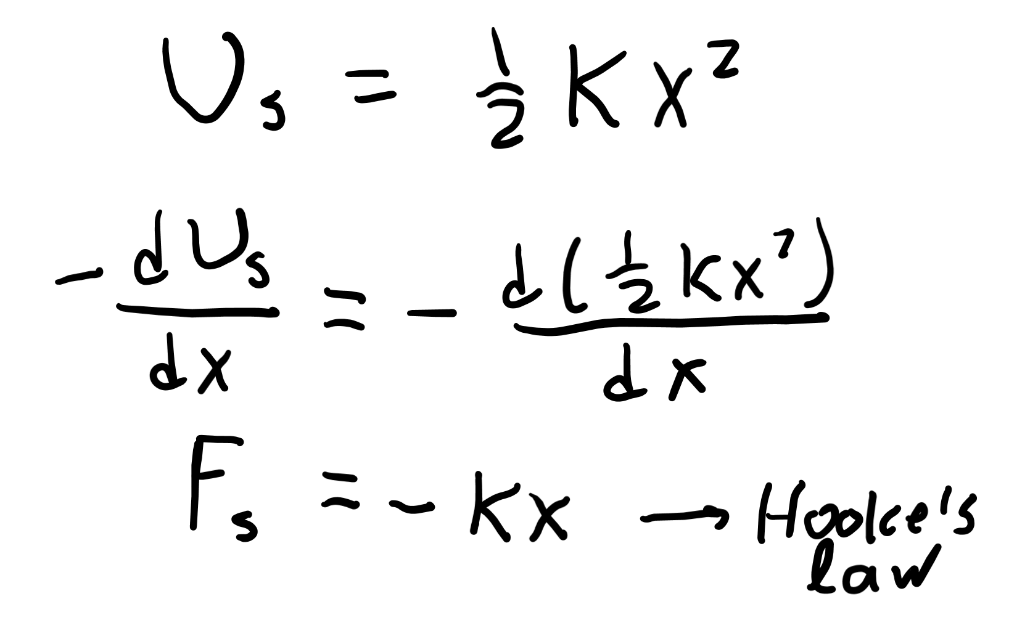
Spring potential example
Taking the negative of the derivative of spring potential energy gives the formula for the spring restoring force, Hooke’s law.

Slide 13
Gravitational potential

Slide 14
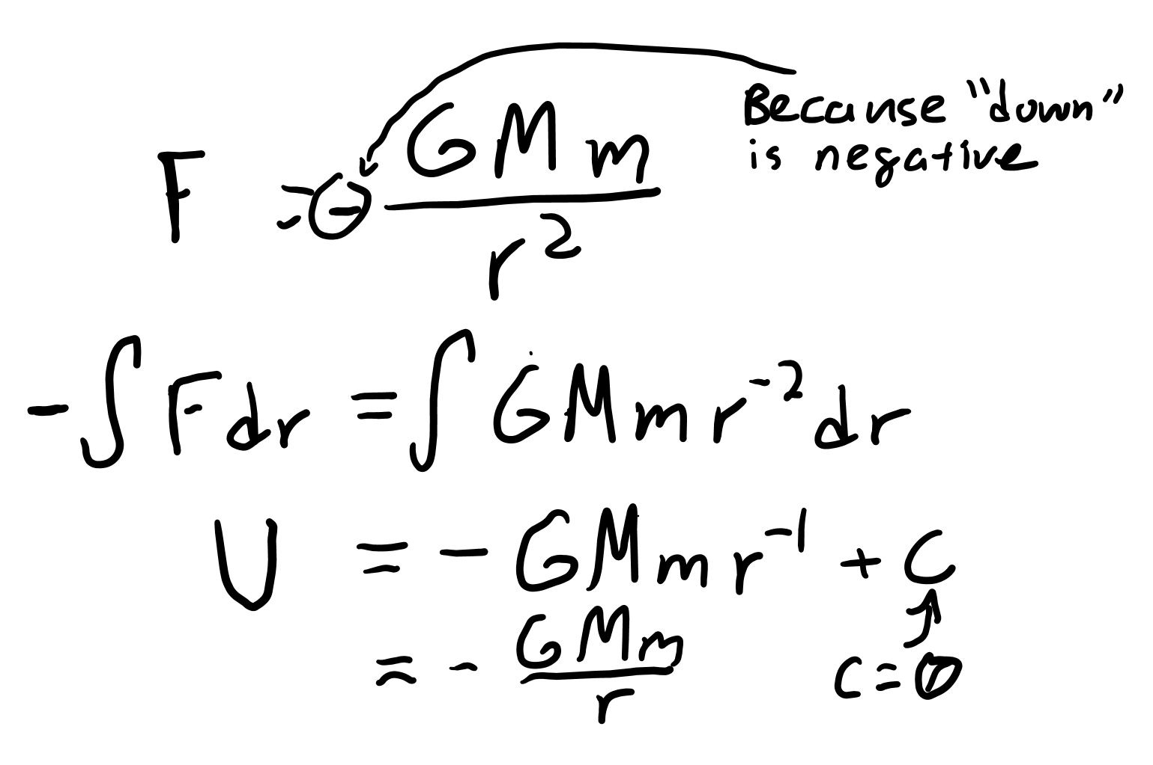
Derivation of gravitational potential
You take newton’s law of gravitation: F = -GmM/r² and integrate it by r, since the integral of force with respect to distance is work.
This gives U = -GmM/r, where U represents gravitational potential energy.

Slide 15
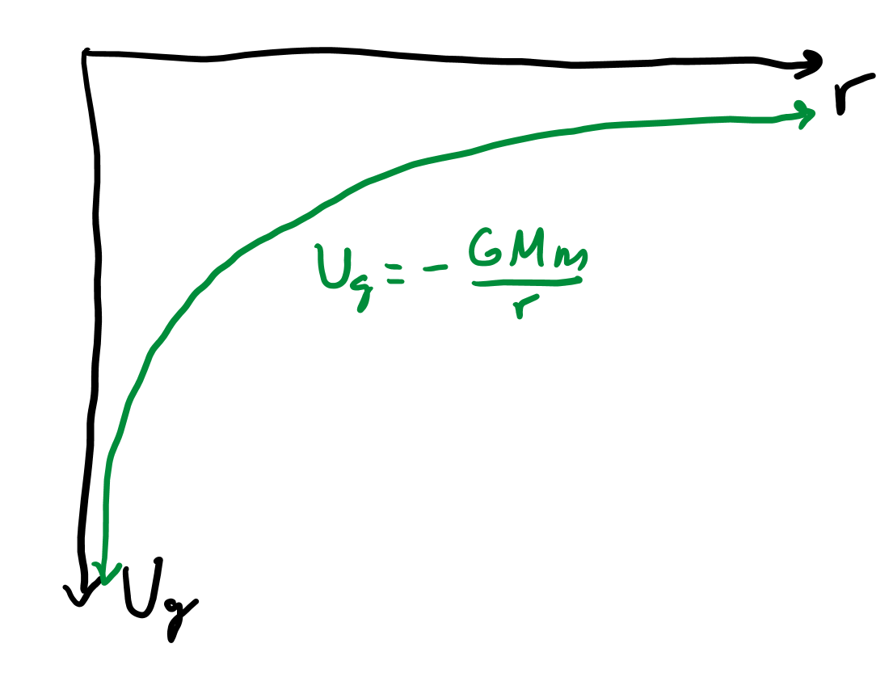
Bounds
In U = -GmM/r, note that G, m, M, and r are all positive, so U is never positive.
An object infinite distance away from a mass has 0 gravitational potential energy while an object 0 distance away from the center of a mass has negative infinity gravitational potential energy.

Slide 16
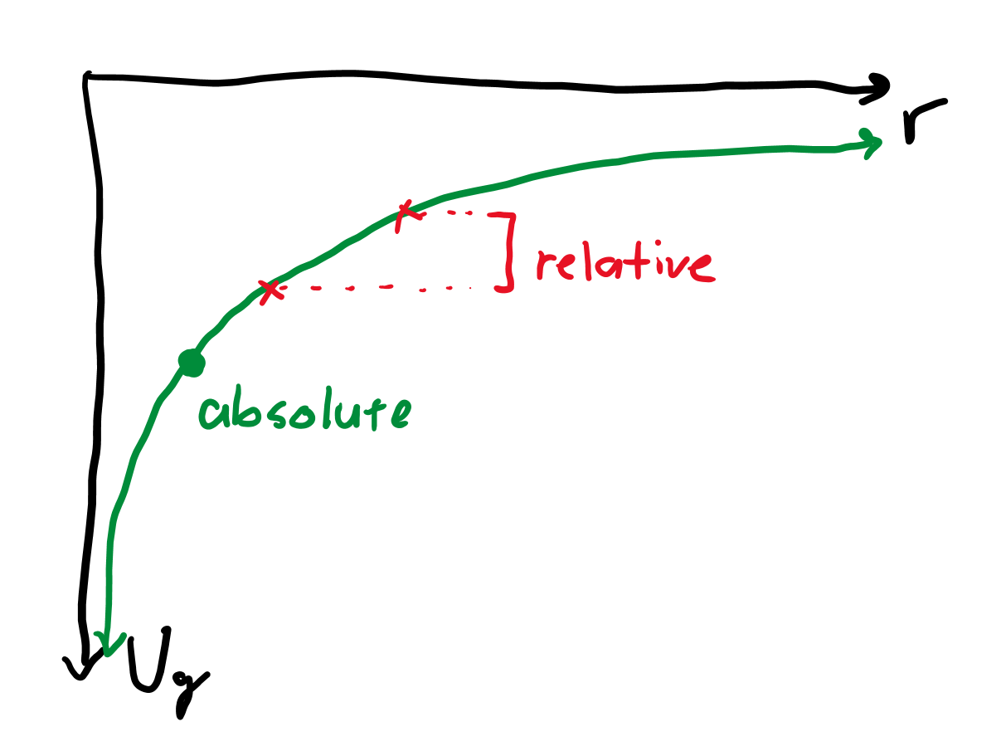
Relative vs. absolute potential
Absolute gravitational potential energy is given by the formula U=-GmM/r.
However, I can also ask for the potential energy difference relative to, say, the floor, which would be non-absolute.
Just saying “potential energy” could refer to either, so use context to find which one.

Slide 17
Relative potential equation
Let’s say we’re on a cliff h meters higher from the surface of the earth with radius r.
Thus, we can say ΔU = GmMh/r².
We know g = GM/r², and mgh = GmMh/r² = ΔU.
U_{surface} = -GmM/r and U_{cliff} = -GmM/(r+h), so ΔU = GmMh/(r²+rh).
This is why we can say relative potential energy has the equation mgh.
Since h is small compared to r, rh is approximately zero.

Slide 18
Escape velocity

Slide 19
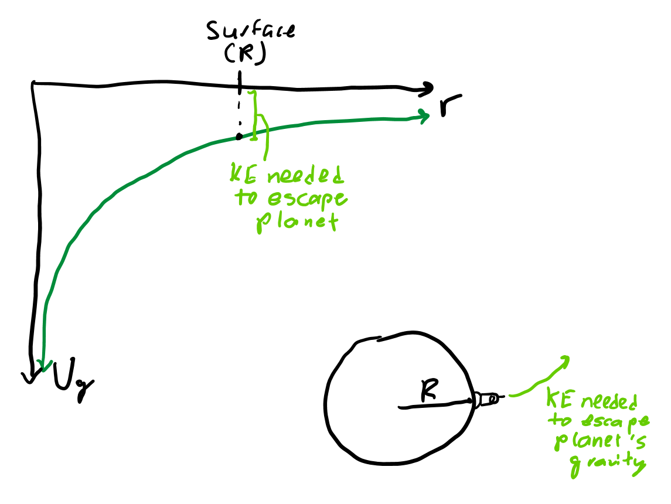
Overcoming potential
We know U = -GmM/r, so to overcome this potential energy, we need KE = +GmM/r = ½ mv².
Thus, v = sqrt(2GM/r) is enough velocity for a mass to overcome gravitational potential energy.
This is called the escape velocity.

Slide 20
Orbital kinetic energy

Slide 21
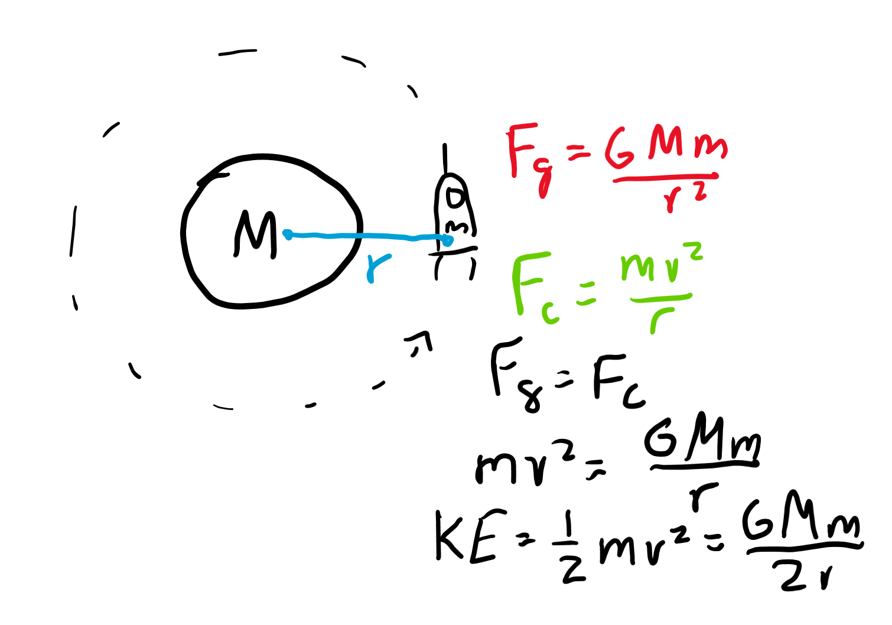
Velocity in orbit
Unlike escape velocity, this KE comes from an object having velocity in orbit.
Since F_{centripetal} = GmM/r² = mv²/r, v = sqrt(GM/r).
KE = ½ mv² = GmM/(2r), which is orbital kinetic energy.

Slide 22
Total orbital energy

Slide 23
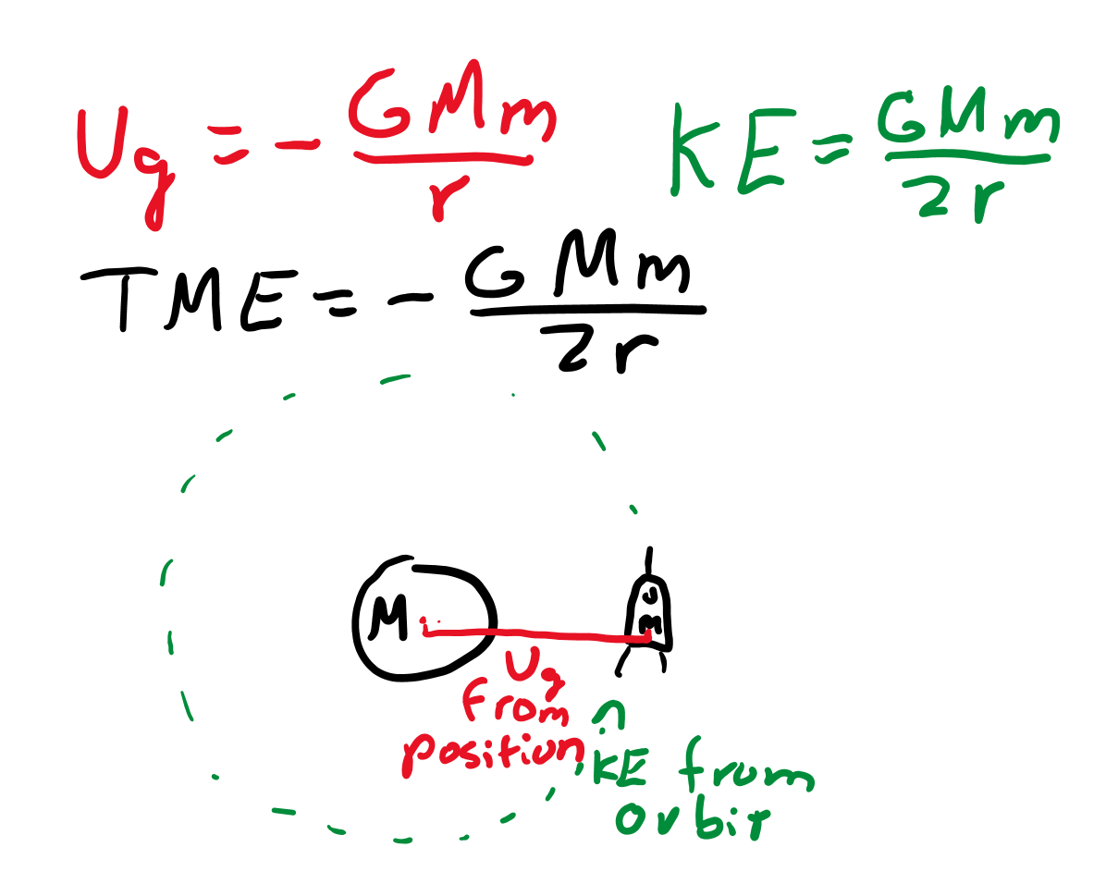
Gravitational mechanical energy
We know TME = U + KE.
As U = -GmM/r and KE = +GmM/(2r), the sum of the two is -GmM/(2r) = TME in orbit.
Notice that TME = ½ U = -KE.

Slide 24
Rotational kinetic energy

Slide 25
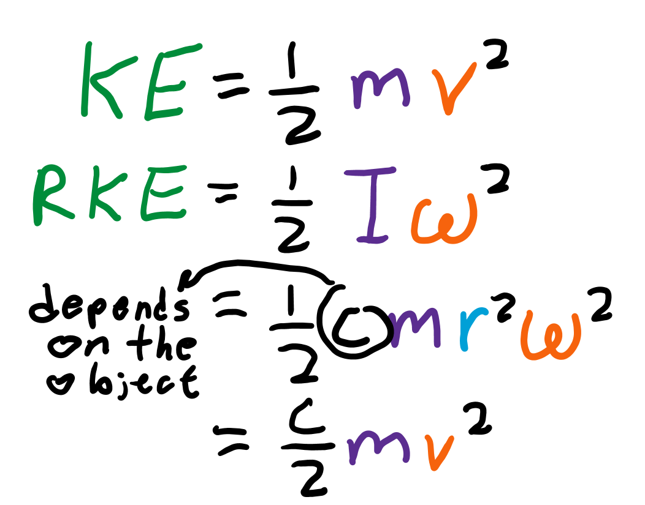
Formula
KE = ½ mv² for linear motion, so KE = ½ Iω² for rotational motion.
Since I is usually cmr² for some constant c and ω = v/r, rotational KE = ½ cmv².
Total KE is the sum of the two, which is usually ½ mv² + ½ cmv² = kmv² for some constant k.

Slide 26
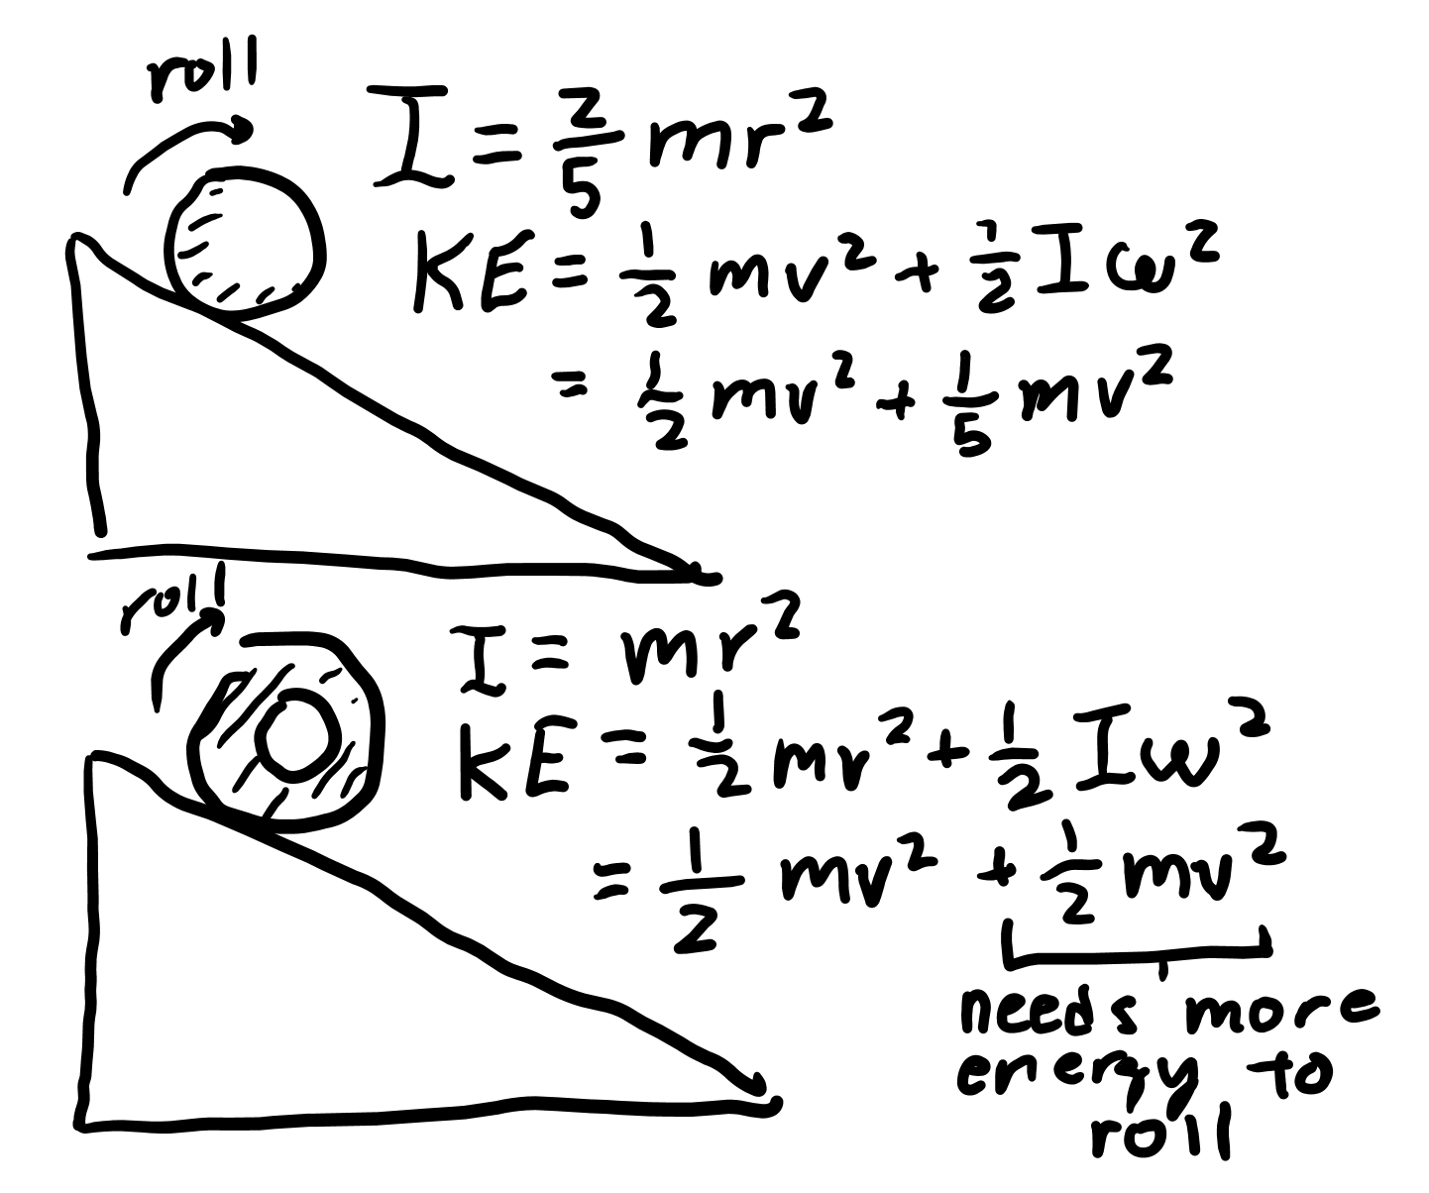
Total energy of rolling objects
Objects rolling down a ramp will convert U to KE.
Objects with larger I have larger rotational KE, meaning they have less linear KE.
Thus, objects with larger I take longer to get down a ramp (move slower linearly).

Slide 27
Rolling

Slide 28
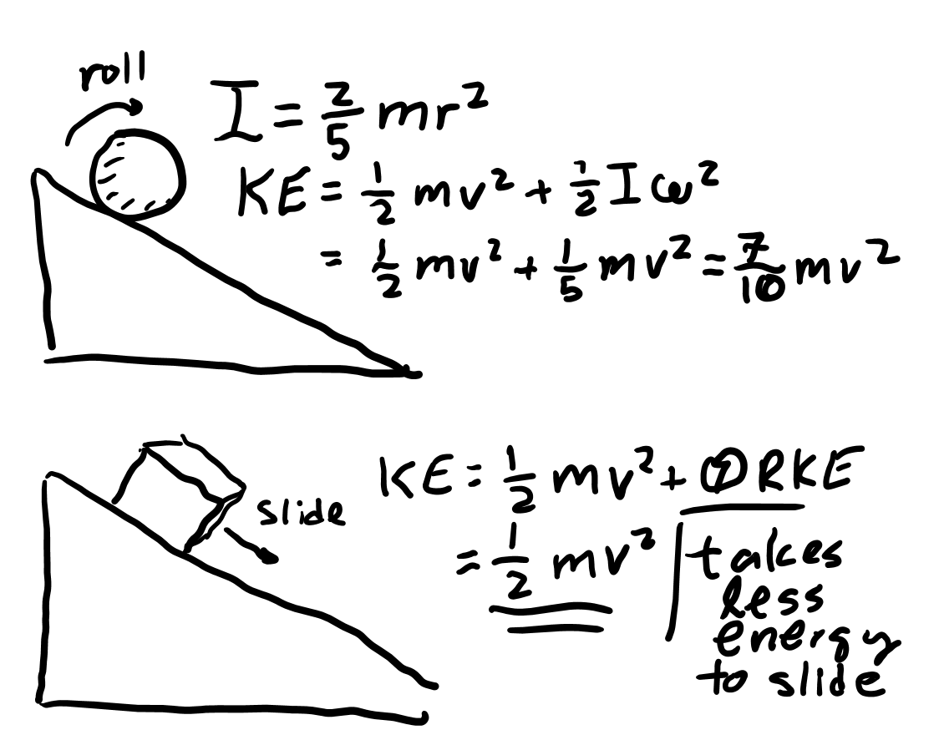
Friction as torque
Friction acts perpendicular to the axis of rotation of an object, causing them to roll.
Rolling without slipping means that v/r = ω, but an object that is slipping will have less ω than v/r.
Note objects that slip will have less rotational KE, so will have more linear KE and go down ramps faster.

